Slide 1
WebFuzzer ( Pentesting Tool Made for testing at production)
DEPARTMENT OF COMPUTER SCIENCE AND ENGINEERING(CYBER SECURITY)
DOMAIN : CYBERSECURITY AND PENTESTING
PD LAB 4
Presented
by
T.S VISHNU
K. YUGENDAR
PRESENTED TO :
V. VINOTH KUMAR SIR

Slide 2
AIM
The aim of this project is to develop a comprehensive web application fuzzer that automates the discovery of hidden vulnerabilities in web applications. This tool will help security professionals and developers identify security flaws before attackers can exploit them.
The fuzzer will scan for:
✔ Hidden Directories & Files – Detect unlisted resources that might contain sensitive data.
✔Virtual Hosts (VHosts)– Identify misconfigured or hidden subdomains.
✔API Endpoints – Locate exposed API routes and test for weaknesses.
✔ URL Parameters– Discover injectable parameters vulnerable to SQLi, XSS, etc.
✔Subdomains – Perform brute-force enumeration to find overlooked subdomains.

Slide 3
ABSTRACT
The fuzzer automates directory enumeration, virtual host discovery, API endpoint identification, URL parameter fuzzing, and subdomain enumeration. It provides custom test case integration, allowing users to define specific attack scenarios tailored to their web applications. Additionally, real-time reporting and logging help security professionals analyze vulnerabilities effectively. By using this tool, developers and penetration testers can proactively secure web applications before they become targets of real-world attacks.

Slide 4
LITERATURE SURVEY
TITLE: Automated Web Application Fuzzing for Enhanced Security
YEAR: 2023
AUTHOR NAME: Various Research Papers & Existing Fuzzing Tools (Burp Suite, DirBuster, OWASP ZAP, etc.)
DESCRIPTION:
Existing web fuzzers have focused on directory brute-forcing, API endpoint discovery, and parameter fuzzing, but they often lack comprehensive automation, structured reporting, and adaptive intelligence. Many available tools perform individual tasks but do not provide a unified approach for directories, virtual hosts, APIs, parameters, and subdomains in a single tool.
Additionally, existing tools lack AI-driven testing and custom test case execution, which can improve accuracy and reduce false positives.
DISADVANTAGES:
Limited Automation – Many tools require manual setup and do not fully integrate different fuzzing techniques.
Lack of Adaptive Intelligence – Most fuzzers do not learn from previous scans or optimize their testing approach dynamically.

Slide 5
LITERATURE SURVEY
TITLE: Web Application Vulnerability Scanners: A Comparative Study
YEAR: 2020
AUTHOR NAME: D. Gupta, S. Sharma, et al.
DESCRIPTION:
This study compares various web application vulnerability scanners such as Burp Suite, OWASP ZAP, Nikto, and Acunetix. The research highlights how these scanners detect common vulnerabilities like SQL injection (SQLi), Cross-Site Scripting (XSS), and misconfigurations. It also examines their effectiveness in real-world applications, emphasizing automation, scan depth, and false positive rates.
DISADVANTAGES:
High False Positives – Many tools generate excessive false positives, requiring manual verification.
Limited Customization – Most scanners follow predefined patterns and do not allow custom test cases.

Slide 6
LITERATURE SURVEY
TITLE: Automated Fuzzing Techniques for Web Application Security
YEAR: 2021
AUTHOR NAME: J. Patel, A. Kumar, et al.
DESCRIPTION:
This paper explores automated fuzzing techniques and their role in identifying security flaws in modern web applications. It discusses different fuzzing methods like mutation-based fuzzing, grammar-based fuzzing, and machine-learning-assisted fuzzing. The study also evaluates the efficiency of existing fuzzers in detecting zero-day vulnerabilities.
DISADVANTAGES:
Time-Consuming – Automated fuzzing can generate thousands of requests, leading to longer scan times.
No AI-Based Optimization – Most fuzzers do not learn from previous tests to optimize future scans.

Slide 7
EXISTING SYSTEM
Currently, web security professionals and ethical hackers rely on various automated security tools like Burp Suite, OWASP ZAP, Nikto, and DirBuster to identify vulnerabilities in web applications. These tools mainly focus on static analysis, predefined payloads, and known attack patterns to detect security weaknesses such as SQL Injection (SQLi), Cross-Site Scripting (XSS), Server Misconfigurations, and Open Directories.
Most existing fuzzers use wordlists and brute-force techniques to find hidden directories, subdomains, API endpoints, and vulnerable parameters. While these tools are effective, they come with several limitations that impact their efficiency and accuracy.

Slide 8
DISADVANTAGES
High False Positives – Many scanners detect vulnerabilities incorrectly, leading to unnecessary manual verification.
Limited Customization – Predefined wordlists and payloads make these tools less flexible for unique test cases.
Slow Performance – Brute-force and exhaustive scanning methods consume a lot of time and resources.
No AI-Based Learning – Existing fuzzers do not adapt or improve based on previous scans.
Lack of Comprehensive Reporting – Reports generated by current tools do not provide detailed remediation steps.

Slide 9
PROPOSED SYSTEM
Our Advanced Web Application Fuzzer overcomes these drawbacks by introducing:
AI-Assisted Adaptive Fuzzing – Learns from previous tests to improve future scans.
Custom Test Cases – Allows users to define specific fuzzing scenarios for advanced vulnerability detection.
Comprehensive Reporting – Generates detailed reports with remediation steps.
Exploit Validation (Future Feature) – Not just recon, but also testing if a vulnerability can be exploited safely.

Slide 10
ADVANTAGES
Multi-Layered Fuzzing – Tests directories, subdomains, API endpoints, URL parameters, virtual hosts, and custom payloads to ensure maximum coverage.
AI-Assisted Learning (Future Scope) – Uses machine learning to adapt and improve fuzzing strategies based on previous scans.
Dynamic Payload Generation – Instead of relying only on predefined wordlists, it will generate payloads dynamically based on the application's response patterns.
Fast & Efficient Scanning – Implements optimized brute-force techniques with rate-limiting and concurrency control to avoid overloading the target server.
Exploit Validation (Future Scope) – Goes beyond just identifying vulnerabilities and safely tests if they can be exploited.

Slide 11
WebFuzzer Description
Our proposed Web Application Fuzzer is a powerful security testing tool designed to intelligently identify and analyze vulnerabilities in web applications. Unlike traditional fuzzers, it performs multi-layered fuzzing across directories, subdomains, API endpoints, virtual hosts, and URL parameters, ensuring comprehensive security coverage. It integrates dynamic payload generation, AI-assisted learning (future scope), and exploit validation to minimize false positives and provide actionable insights

Slide 12
MODULES
fuzzer.py – The main script that orchestrates different fuzzing modules.
directories_fuzzer.py – Handles directory and file enumeration.
vhosts_fuzzer.py – Identifies virtual hosts via Host header fuzzing.
api_fuzzer.py – Detects hidden API endpoints.
parameters_fuzzer.py – Fuzzes URL parameters for vulnerabilities.
subdomain_fuzzer.py – Discovers subdomains through brute-force and DNS enumeration

Slide 13
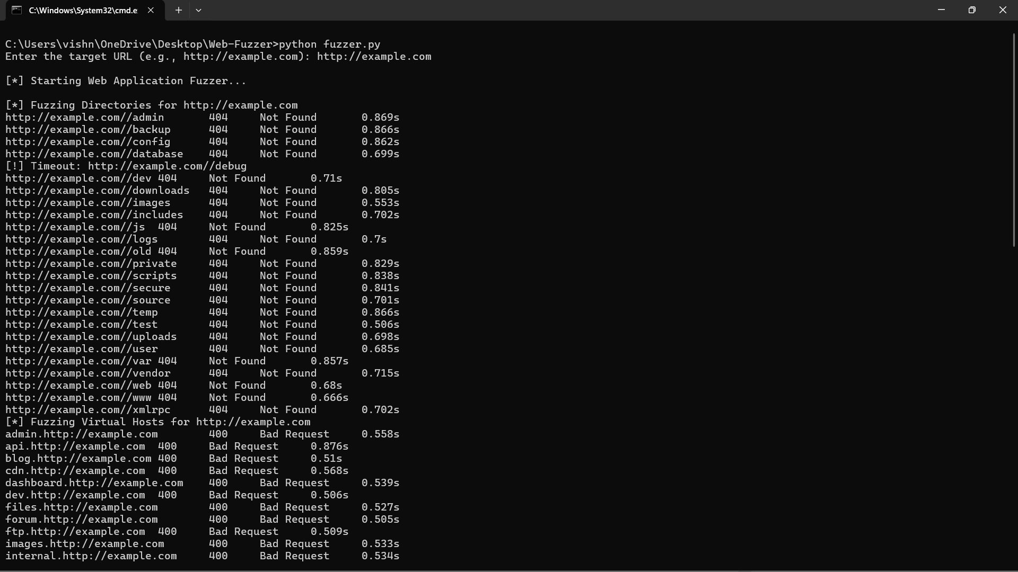
SOFTWARE SCREENSHOTS

Slide 14
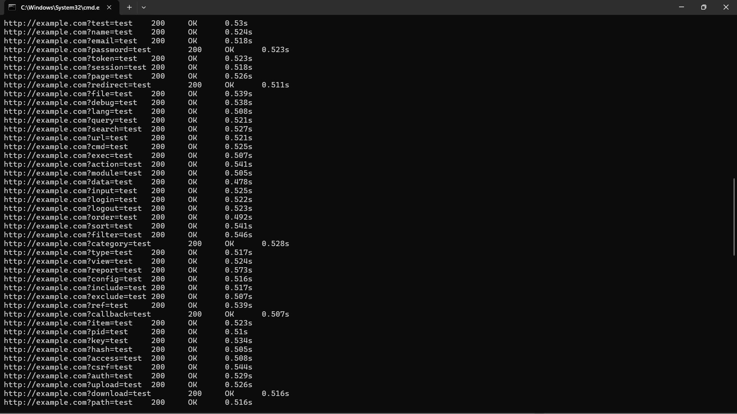
SOFTWARE SCREENSHOTS

Slide 15
PROGRAM-1
from directories_fuzzer import fuzz_directories
from vhosts_fuzzer import fuzz_vhosts
from api_fuzzer import fuzz_api_endpoints
from parameters_fuzzer import fuzz_parameters
from subdomain_fuzzer import fuzz_subdomains
def main():
target_url = input("Enter the target URL (e.g., http://example.com): ").strip()
print("\n[*] Starting Web Application Fuzzer...\n")
fuzz_directories(target_url)
fuzz_vhosts(target_url)
fuzz_api_endpoints(target_url)
fuzz_parameters(target_url)
fuzz_subdomains(target_url)
print("\n[*] Fuzzing Completed. Check 'reports/' for results.")
if __name__ == "__main__":
main()

Slide 16
PROGRAM-1
import requests
import time
def fuzz_directories(target_url, wordlist="wordlists/directories.txt"):
print(f"[*] Fuzzing Directories for {target_url}")
try:
with open(wordlist, "r") as file:
directories = file.read().splitlines()
with open("reports/directories_report.txt", "w") as report:
for directory in directories:
url = f"{target_url}/{directory}"
try:
start_time = time.time()
response = requests.get(url, timeout=2)
elapsed_time = round(time.time() - start_time, 3)
status_message = response.reason
log_entry = f"{url}\t{response.status_code}\t{status_message}\t{elapsed_time}s"

Slide 17
PROGRAM-1
print(log_entry)
report.write(log_entry + "\n")
except requests.exceptions.Timeout:
print(f"[!] Timeout: {url}")
except requests.exceptions.RequestException as e:
print(f"[X] Error: {url} - {e}")
except Exception as e:
print(f"[-] Error: {e}")

Slide 18
PROGRAM-1
import requests
import time
def fuzz_vhosts(target_url, wordlist="wordlists/subdomains.txt"):
print(f"[*] Fuzzing Virtual Hosts for {target_url}")
try:
with open(wordlist, "r") as file:
vhosts = file.read().splitlines()
with open("reports/vhosts_report.txt", "w") as report:
for vhost in vhosts:
headers = {"Host": f"{vhost}.{target_url}"}
try:
start_time = time.time()
response = requests.get(target_url, headers=headers, timeout=2)
elapsed_time = round(time.time() - start_time, 3)
status_message = response.reason
log_entry = f"{vhost}.{target_url}\t{response.status_code}\t{status_message}\t{elapsed_time}s"

Slide 19
PROGRAM-1
print(log_entry)
report.write(log_entry + "\n")
except requests.exceptions.Timeout:
print(f"[!] Timeout: {vhost}.{target_url}")
except requests.exceptions.RequestException as e:
print(f"[X] Error: {vhost}.{target_url} - {e}")
except Exception as e:
print(f"[-] Error: {e}")

Slide 20
CONCLUSION
Our Web Application Fuzzer successfully automates the process of discovering hidden directories, virtual hosts, API endpoints, URL parameters, and subdomains, aiding in web application security testing. By systematically testing these components, the fuzzer helps identify potential vulnerabilities such as insecure authentication, sensitive data exposure, misconfigurations, and injection flaws. The tool provides detailed reports, enabling security teams and developers to address issues before deployment, ensuring a robust and secure web application.

Slide 21
REFERENCE
Research Papers & Articles:
OWASP Web Security Testing Guide – https://owasp.org/www-project-web-security-testing-guide/
Fuzz Testing: The Past, Present, and Future – https://ieeexplore.ieee.org/document/9233511
A Study on Web Application Vulnerabilities and Security Testing Approaches – https://www.sciencedirect.com/science/article/pii/S1877050917322279
Tools & Documentation:
Burp Suite – Web Security Scanner – https://portswigger.net/burp
DirBuster – Directory Brute-Forcing – https://www.owasp.org/index.php/Category:OWASP_DirBuster_Project
Ffuf (Fast Fuzzer) – Advanced Web Fuzzing Tool – https://github.com/ffuf/ffuf
SQLMap – Automated SQL Injection Testing – https://sqlmap.org/

Slide 22

“THANK YOU”

